Slide 1

The five-step Method
MTH 564 – Mathematical Modeling

Slide 2

Installation of Python
Mathematical Modeling
“All models are wrong, but some models are useful.”
-- George E. P. Box
“The best material model of a cat is another, or preferably the same, cat.”
-- Norbert Weiner

Slide 3
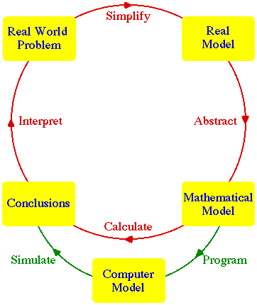
Installation of Python
Mathematical Modeling
Mathematical Modeling
It’s a cycle
Communication is very important - it’s not enough just to solve the problem
Most models are of the type - Optimization Models - Dynamic Models - Probability Model - (or a combination)
Problems are all “story problems”
Typically require the use of appropriate technology (CAS, Numerical Methods, Statistical packages)

Slide 4
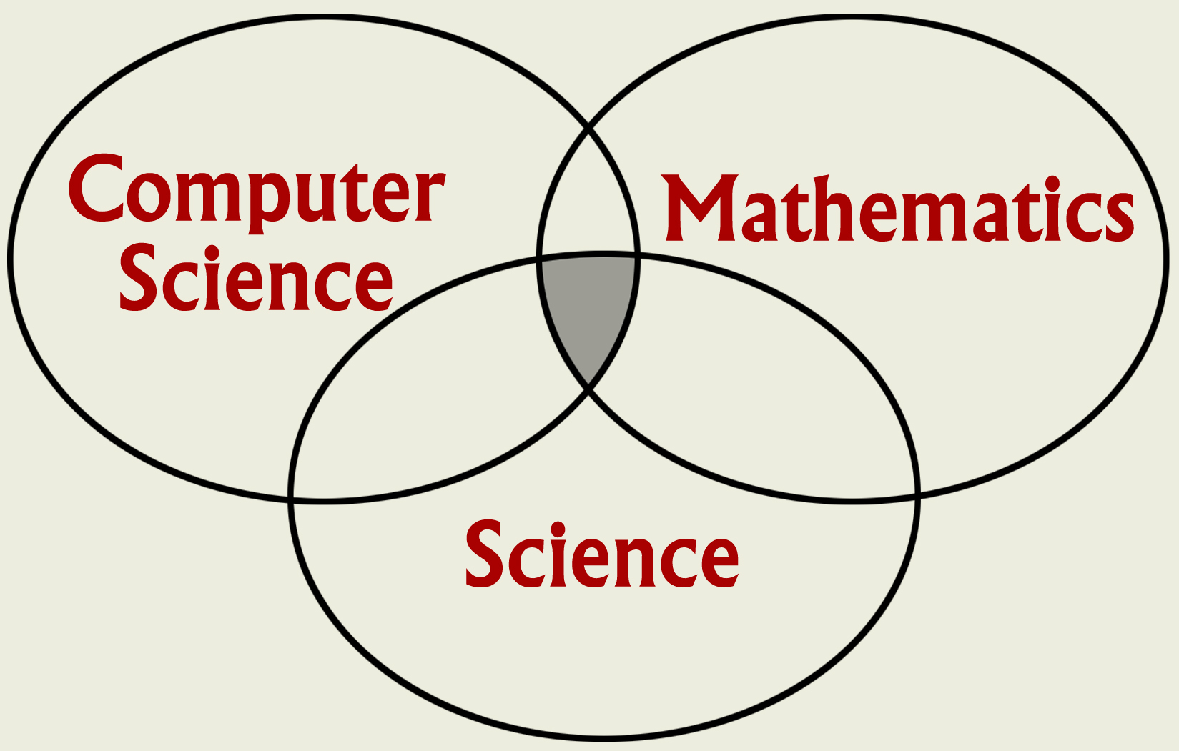
Mathematical Modeling
Many times mathematical modeling involves teamwork
It is often used in place of experiments when experiments are too large, too expensive, too dangerous, or too time consuming.
Can be useful in “what if” studies; e.g. to investigate the use of pathogens (viruses, bacteria) to control an insect population.

Slide 5
Mathematical Modeling
Has emerged as a powerful, indispensable tool for studying a variety of problems in scientific research, product and process development, and manufacturing.
Seismology
Climate modeling
Economics
Environment
Material research
Drug design
Manufacturing
Medicine
Biology

Slide 6
Example of Mathematical Modeling
Boeing 777
First jetliner to be digitally designed, "pre-assembled" on computer, eliminating need for costly, full-scale mockup.
Computational modeling improved the quality of work and reduced changes, errors, and rework.

Slide 7


Example: Roadmaps of the Human Brain
MRI
Cortical regions activated as a subject remembers the letters x and r.
Real-time Magnetic Resonance Imaging (MRI) technology may soon be incorporated into dedicated hardware bundled with MRI scanners allowing the use of MRI in drug evaluation, psychiatry, & neurosurgical planning.

Slide 8
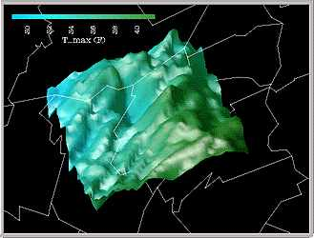
Example: Climate Modeling
Climate
3-D shaded relief representation of a region using color to show max daily temperatures.
Displaying multiple data sets at once helps users quickly explore and analyze their data.

Slide 9
Fives Steps to Modeling
Step 1. Ask the question. (Frame the question.)
Make a list of variables, including appropriate units. (Don’t confuse constants with variables.)
State assumptions about these variables, including equations and inequalities.
You might have to guess and refine
Check units to verify assumptions make sense.
State the objective of the problem in precise mathematical terms.

Slide 10

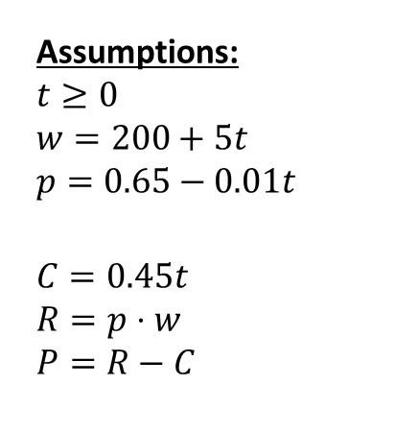
Example: Selling a Pig – Step 1
We should probably check units to make sure our assumptions are correct.
A pig weighing 200 lbs. gains 5 lbs. per day and costs $0.45 a day to keep. The market price for pigs is $0.65 per lb., but is falling by $0.01 per day. When should the pig be sold?
Variables:
t – time (in days)
w – weight of pig (lbs.)
p – price for pigs ($/lb.)
C – cost of keeping pig
R – revenue obtained by selling the pig
P – profit
Assumptions:
$$t≥0$$
$$w=200+5t \\ p=0.65−0.01t$$
$$C=0.45t \\ R=p⋅w \\ P=R−C$$
Objective
Maximize $P$
Constants:
200 – starting weight of pig
5 – rate of change of pig’s weight
$0.45 – cost per day
$0.65 – price per pound
$0.01 – amount the price decreases per day

Slide 11
Step 2 of five-step method
Step 2. Select the modeling approach
Identity a procedure or method that can be used to solve the problem or approximate the solution
This step can be difficult and often requires experience.
In this course we will examine three categories of models (with various subcategories):
Optimization Models
Dynamic Systems
Probability and Statistical Models
Sometimes you have to combine approaches

Slide 12
Optimization Models
Optimization Models
Goal is to determine the value of control variables which maximize or minimize something of interest
Variables typically have constraints of some type on them
One of the most common types of problems
They cannot always be solved exactly
Example
Corporations like to maximize profit, minimize cost, etc.
Farmers try to maximize yield
Computer systems managers try to maximize bandwidth and minimize delays

Slide 13
Example: Selling a Pig – Step 2
Profit can be expressed just in terms of t, so this is an one-variable optimization problem.
A pig weighing 200 lbs. gains 4 lbs. per day and costs $0.45 a day to keep. The market price for pigs is $0.65 per lb., but is falling by $0.01 per day. When should the pig be sold?
Variables:
t – time (in days)
w – weight of pig (lbs.)
p – price for pigs ($/lb.)
C – cost of keeping pig
R – revenue obtained by selling the pig
P – profit
Assumptions:
$$t≥0$$
$$w=200+5t \\ p=0.65−0.01t$$
$$C=0.45t \\ R=p⋅w \\ P=R−C$$
Objective
Maximize $P$
Constants:
200 – starting weight of pig
5 – rate of change of pig’s weight
$0.45 – cost per day
$0.65 – price per pound
$0.01 – amount the price decreases per day

Slide 14
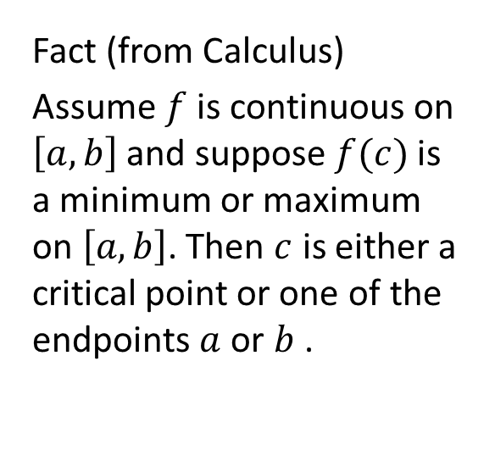
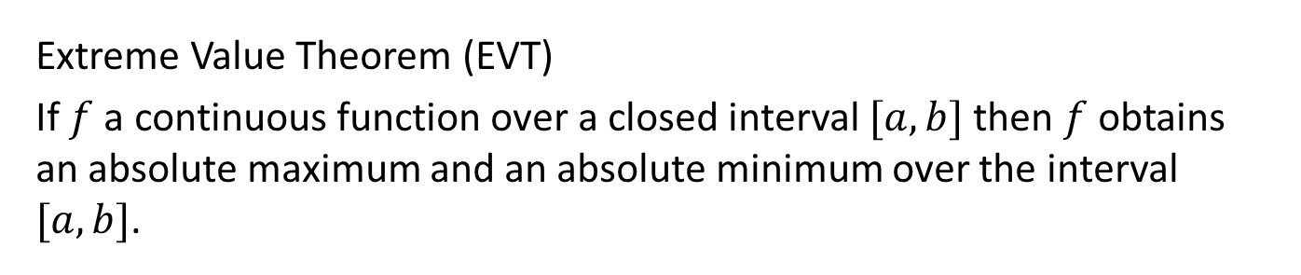
Extreme Value Theorem (Calculus I)
Extreme Value Theorem (EVT)
If $f$ a continuous function over a closed interval $[a,b]$ then $f$ obtains an absolute maximum and an absolute minimum over the interval $[a,b]$.
Fact (from Calculus)
Assume $f$ is continuous on $\left[a,b\right]$ and suppose $f(c)$ is a minimum or maximum on $\left[a,b\right]$. Then $c$ is either a critical point or one of the endpoints $a$ or $b$ .

Slide 15
Step 3 of five-step method
Step 3. Formulate the model.
Recast the question from Step 1 in terms of the modeling approach we are using in Step 2.
It is often convenient to relabel variables to align with the notation of Step 2.
Make note of any additional assumptions.

Slide 16
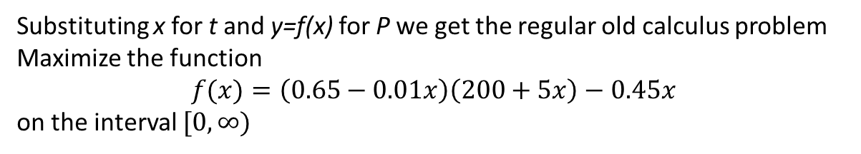
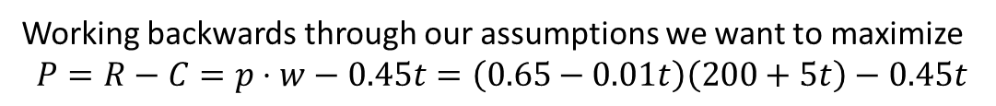
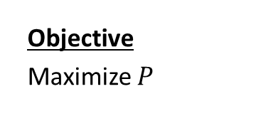
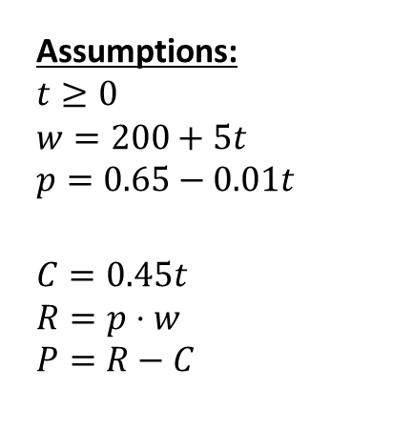
Example: Selling a Pig – Step 3
Variables:
t – time (in days)
w – weight of pig (lbs.)
p – price for pigs ($/lb.)
C – cost of keeping pig
R – revenue obtained by selling the pig
P – profit
Assumptions:
$$t≥0$$
$$w=200+5t \\ p=0.65−0.01t$$
$$C=0.45t \\ R=p⋅w \\ P=R−C$$
Objective
Maximize $P$
Constants:
200 – starting weight of pig
5 – rate of change of pig’s weight
$0.45 – cost per day
$0.65 – price per pound
$0.01 – amount the price decreases per day
Working backwards through our assumptions we want to maximize
$$P=R−C=p⋅w−0.45t=\left(0.65−0.01t\right)\left(200+5t\right)−0.45t$$
Substituting x for t and y=f(x) for P we get the regular old calculus problem Maximize the function
$$f(x)=\left(0.65−0.01x\right)\left(200+5x\right)−0.45x$$
on the interval $[0,∞)$

Slide 17
Step 4 of five-step method
Step 4. Solve the model.
Apply the procedure from Step 2 to the problem formulated in step 3.
Check for errors and confirm the solution makes sense.
Here is where we want to incorporate appropriate technology to reduce the chance for error and help to verify results.

Slide 18
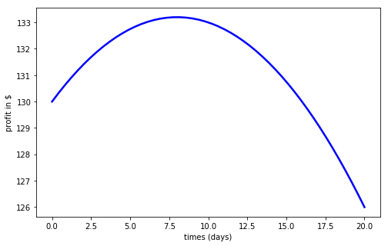
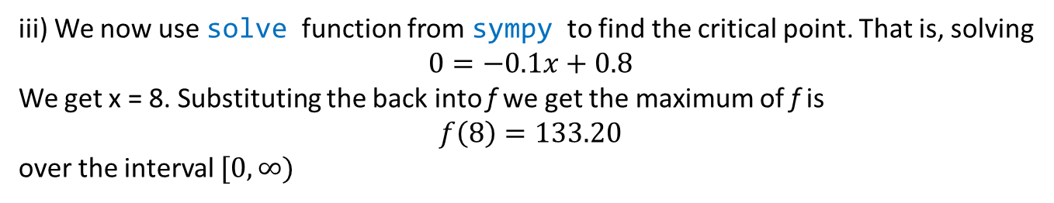

Example: Selling a Pig – Step 4
Maximize the function
$$f(x)=\left(0.65−0.01x\right)\left(200+5x\right)−0.45x$$
on the interval $[0,∞)$
i) Since the function is not on a closed interval we plot the function to figure out where the max might be
ii) We now use sympy in python to find the derivative
$$f^{′}\left(x\right)=−0.1x+0.8$$
iii) We now use solve function from sympy to find the critical point. That is, solving
$$0=−0.1x+0.8$$
We get x = 8. Substituting the back into f we get the maximum of f is
$$f\left(8\right)=133.20$$
over the interval $[0,∞)$
Notes:
Note that f’ > 0 for x > 8 and f’ < 0 for x < 8, so (8,f(8)) is a local max
See python file section1-1pig.py

Slide 19
Step 5 of five-step method
Step 5. Answer the question.
Restate the results of Step 4 to answer the problem posed in Step 1.
Avoid technical jargon and mathematical symbols.
Anyone that can understand the original question should be able to understand your solution.
Note: Do NOT underestimate this step. It can be challenging to communicate mathematics to your peers or even your professor. Communicating mathematics to someone that is not as knowledgeable as you can be downright difficult.

Slide 20
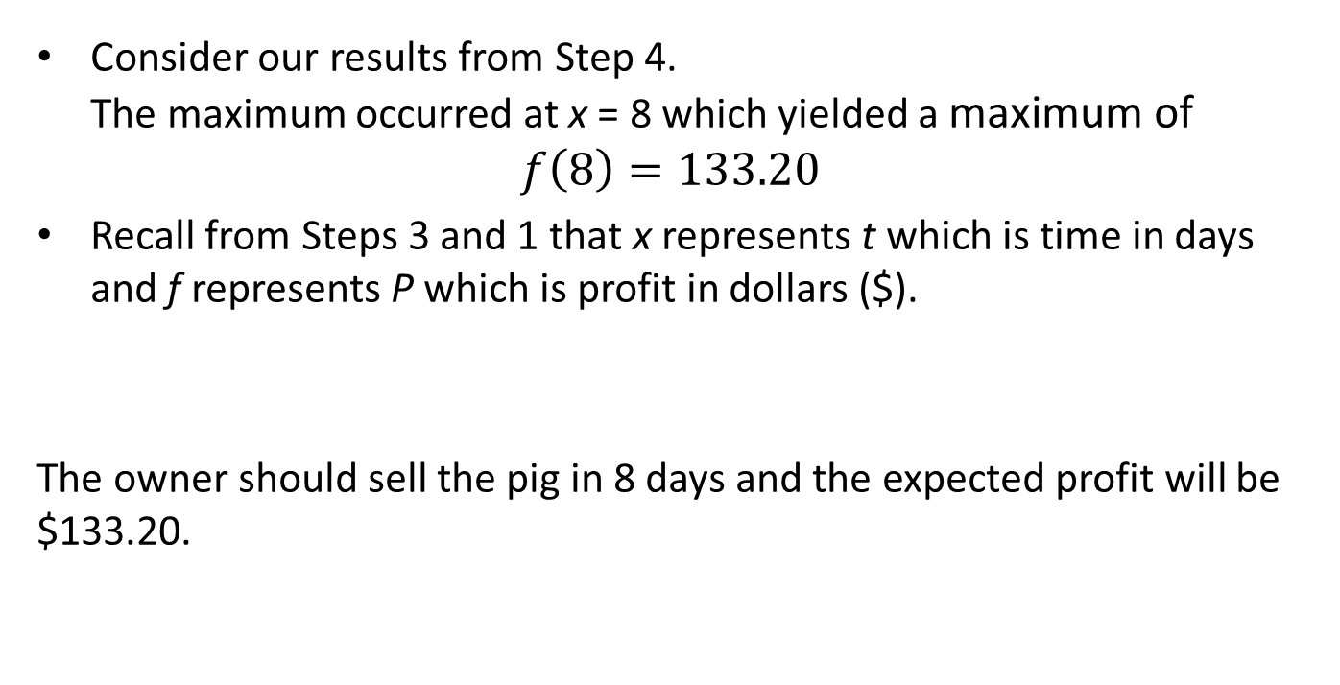
Example: Selling a Pig – Step 5
Consider our results from Step 4. The maximum occurred at x = 8 which yielded a maximum of
$$f\left(8\right)=133.20$$
Recall from Steps 3 and 1 that x represents t which is time in days and f represents P which is profit in dollars ($).
The owner should sell the pig in 8 days and the expected profit will be $133.20.

Slide 21
The five-step method
Summary
Step 1. Ask the question.
Step 2. Select the modeling approach.
Step 3. Formulate the model.
Step 4. Solve the model.
Step 5. Answer the question.

Slide 22
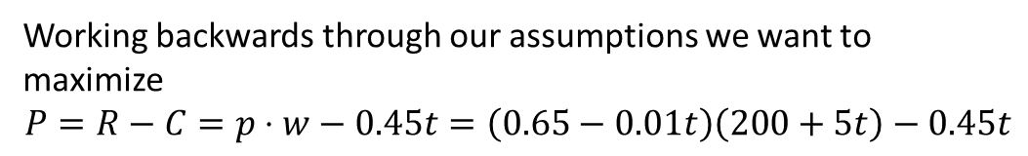
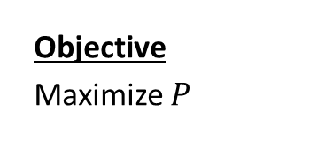
Spoiler: What’s Next?
Variables:
t – time (in days)
w – weight of pig (lbs.)
p – price for pigs ($/lb.)
C – cost of keeping pig
R – revenue obtained by selling the pig
P – profit
Assumptions:
$$t≥0$$
$$w=200+5t \\ p=0.65−0.01t$$
$$C=0.45t \\ R=p⋅w \\ P=R−C$$
Objective
Maximize $P$
Constants:
200 – starting weight of pig
5 – rate of change of pig’s weights
$0.45 – cost per day
$0.65 – price per pound
$0.01 – amount the price decreases per day
Working backwards through our assumptions we want to maximize
$$P=R−C=p⋅w−0.45t=\left(0.65−0.01t\right)\left(200+5t\right)−0.45t$$
If a measurement for one of our constant’s is wrong or it changes, how much does that affect our solution?

